Slide 1
Guide to Redesign Work in the Human-Machine Era
Gartner for HR Leaders
Notes:
Ver 2026-0114
Presenter's Name
Presenter's Name

Slide 2
Contents
Dynamic Work Redesign Cycle
Cycle Overview and HR Function role in Work Redesign
Step 1: Align on Design Goals and Key Value Streams
Step 2: Assess Process Performance
Step 3: Define People and Technology Contribution
Align work to technology value and task complexity
Assess return vs. feasibility and change effort
Step 4: Redesign Processes
Step 5: Redesign Jobs and Assess Impact
Dynamic Redesign: Continuous Adaptation
Resourcing & Readiness for Enterprise Work Redesign
Enterprise Governance and Resourcing
Process Maturity and Data Readiness as a Central Enablers
Appendix: Glossary, Sample Value Stream Maps

Slide 3

Overview: Work Redesign Cycle
Co-own strategic work redesign principles, governance, and strategic direction for work redesign, as member of the C-Suite.
Lead workforce planning, job design, culture, talent, and change to align people and processes with evolving priorities and technology opportunities.
Redesign jobs, and assess impact
5
1
Align on design goals and key value streams
Recalibrate
Reset
Repeat
Redesign processes
4
2
Assess process performance
3
Define people + technology contribution
Guidance:
Drive strategic governance: Align on redesign priorities, principles, outcomes, and accountability across the enterprise..
Balance return vs. feasibility: Prioritize optimization initiatives based on return (employee, investment, future) vs. complexity and change effort.
Lead culture and change leadership: Champion adaptability and guide workforce through transformation.
Build capability in process excellence and task intelligence: Enable smarter workflows, automation opportunities, and human-centric redesign.
Recalibrate, reset, and continuously adjust processes, jobs, and capabilities to evolving demands and technologies.

Slide 4
Key Steps and HR Function Contribution
CHRO role | Value Stream and Process Optimization
Co-own as ExecCo member. Contribute to strategic alignment discussions | Step 1: Align on Design Goals and Key Value Streams Align on strategic design goals and principles, including AI and technology readiness. Prioritize key value stream activities/capabilities based on impact and return.
Guide HR Function contribution to cross functional effort | Step 2: Assess Process Performance Provide insights on performance related, capability, or capacity related pain points and employee experience. Engage broadly: Top-down alignment and bottom-up input. Orchestrate cross-functional accountability. Involve those closest to the work.
 | Step 3: Define People + Technology contribution Identify the work done by humans. Assess current tech and how it supports efficiency, employee experience, and business needs. Champion human-centric design and engage in decisions as to which tasks stay human vs. shift to tech, ensuring alignment with workforce capabilities, brand/trust moments, regulatory guardrails and design principles. Evaluate optimization/technology opportunities considering return, change effort and feasibility.
 | Step 4: Redesign future processes Partner to embed workforce considerations in workflows. Enable Dynamic Redesign, and a cycle for ongoing adjustments backed by HR-led change management.
HR Leadership and ownership of work + workforce alignment | Step 5: Redesign jobs and assess impact Own job redesign and capability planning and address talent implications. Lead reskilling, change management, and communication.
Co-own as ExecCo member. Embed dynamic design as capability | Continuous Adaptation: People, Process, Technology Strengthen process excellence and AI capabilities to enable continuous adaptation. Embed a recurring recalibration cycle with reskilling, change readiness, and regular talent alignment reviews.

Slide 5

1. Align on Design Goals and Key Value Streams
CHRO Role: Co-own as member of Exec Co
What are the highest-value opportunities?
Guidance
Work redesign is not just about efficiency; it’s about aligning capability and capacity with strategic differentiation and prioritization. Value streams* create a shared view of where business value is generated or lost across functions. Any redesign must be in the context of the business strategy. Be clear on your design goals, e.g., Are you designing for growth, cost optimization? As part of the executive team, contribute to strategic alignment discussions: Align the C-Suite on Redesign Goals: Identify and agree on core principles to guide design activities and decisions. Identify High-Value Streams for Optimization Map value streams to pinpoint where business value is created or lost. Focus on steps with the most significant potential for optimization and technology/AI integration. Prioritize based on strategic goals, business capabilities and return: Differentiated & Core Capabilities: Emphasize innovation and operational effectiveness to strengthen competitive advantage. Requisite & Noncore Capabilities: Drive efficiency and cost optimization to reduce complexity and improve scalability. Select priority focus: Approve 4 to 5 value stream steps with the highest potential ROI based on business impact and feasibility. Assign Ownership: Ensure clear accountability for each priority area to deliver end-to-end performance and measurable outcomes.
Example: E-Commerce Organization
Arrange Collection
Transport
Shipment
Deliver Shipment
Bill
Customer
Customer
Request
Customer
Business Capabilities
Engage Customer
Manage Delivery
Invoice Customer
Create Service
Arrange Pickup
Create Transaction
Confirm Delivery
Transport Shipment
Create Invoice
Clear Customs
Collect Payment
Identify Delivery Route
Deliver Shipment
Strategy
Organization design goals & principles
Capability legend
Priority focus
Differentiating
Core
Requisite
Non-core
Source: Gartner
(* See glossary for Gartner value stream definition)
Notes:
766498_C
Engage Customer
Create Service. Differentiated Rationale: Opportunity to personalize services (same-day, green delivery, time-slot premium), co-create offers, and design CX.
Confirm Delivery. Requisite Rationale: Standard notification; must be accurate and timely, not a differentiator.
Manage Delivery
Arrange Pickup. Core Rationale: Critical operational step; can be improved for reliability and cost but typically not unique.
Transport Shipment .Core Rationale: Backbone logistics; focus on throughput, cost, and SLA adherence.
Clear Customs .Requisite (core for cross‑border) Rationale: Compliance is mandatory; accuracy > speed; usually standardized to minimize risk.
Identify Delivery Route .Differentiated Rationale: Dynamic, AI-driven routing impacts speed, reliability, sustainability, and cost; key CX lever.
Deliver Shipment. Differentiated Rationale: The moment of truth. On-time, precise ETAs, proactive comms, in-flight changes, white-glove options.
Invoice Customer
Create Transaction. Requisite Rationale: Standard order-to-cash record creation; accuracy and integration matter.
Create Invoice. Requisite Rationale: Non-differentiating back office; aim for error-free automation.
Collect Payment. Core Rationale: Cashflow-critical; optimize for approval rates, fraud management, and fee reduction.

Slide 6


2. Assess Process Performance
CHRO Role: HR Function Collaboration
Where are the current pain points or risks: performance, data, capacity, customer or employee experience?
Guidance
Jointly drive enterprise accountability for value stream optimization, ensuring HR contribution to the cross-functional effort to assess value stream and process performance. Review and Diagnose: Diagnose where value is created or lost — optimize for outcomes, not just speed (e.g., cost per transaction, customer Net Promoter Score). Use Data-Driven Insights: Analyze workflow data to reveal friction points, handoffs, delays. Leverage quantitative and qualitative inputs. Include task mining insights to uncover inefficiencies that impact process performance. Engage Broadly: Champion top-down alignment and bottom-up input. Involve those closest to the work to build engagement and readiness. Orchestrate cross-functional accountability across IT, Finance, Operations, HR, Risk, and Business Proses Excellence and other leaders.
1. Assess Performance Improvement Opportunities:
Process excellence and efficiency (incl. cost and time)
Reduce delays during and between process steps
Eliminate waste and surplus in production and services
2. Data & Reliability
Improve data, information, relevance, and deliverable reliability
3. Governance, Risk & Decision Making
Manage operational and compliance risks
Simplify ownership and decision rights
4. People, Capacity & Collaboration
Optimize resource allocation and workload balance (Capacity)
Add, upgrade, or rationalize skills (Capability building)
Improve cross-functional coordination/reduce latency
Improve customer and employee experience/engagement.
Note where employees provide nonobvious value beyond task lists
Business Capabilities
Value Stream
Processes/Workflows
Engage Customer
Manage Delivery
Invoice Customer
Arrange Collection
Transport Shipment
Deliver Shipment
Bill Customer
Customer
Request
Customer
Transport shipment
Identify delivery route
Assess process performance within key value streams
(* See glossary for definition of task mining and process intelligence)
Source: Gartner 766498_C

Slide 7
3. Define People + Technology Contribution
CHRO Role: HR Function Collaboration
Which tasks are best performed by humans versus by technology?
Manage Delivery
Deliver Shipment
Guidance
Collaborate as part of the executive team, alongside the CIO and other leaders, to define how people and technology combine for speed, scale, and strategic impact. Champion human-centric design principles and ensure alignment with workforce capabilities., brand/trust moments, regulatory guardrails and design principles Evaluate Tasks Provide workforce insights to identify where human effort is concentrated. Assess current technology and how it supports efficiency, employee experience, and business needs. Map tasks to workflows and processes. Leverage task intelligence to identify repetitive, rule-based steps ripe for automation/augmentation. Key requisite: Avoid automating broken workflows. Decide Who Does What Human-Centric: Tasks requiring judgment, deep knowledge, empathy, or complex decisions Consider brand/trust and regulatory requirements. Augment: Blend human insight + technology for creativity/speed. Automate: Move routine, rule-based tasks to technology. Assess Key Factors: Check readiness across: Technology & Data ¹ Process Stability Workforce Adoption & Change Effort Workforce capabilities readiness Sustainability Cost ($) and Resources (FTE) Note: Detailed investment decisions are made following prioritization.
Identify
delivery route
Define opportunities for automation, augmentation, and people-centric tasks
Category | Tasks | Tools | KPIs
Current Tech | Static route planning; distance-based cost calculation | Trans. Management System | Cost per route
Augment | Dynamic routing with approval; sustain | Dynamic routing module | Delivery accuracy; successful reroutes
Automate | Real-time route optimization; carrier assignment; ETA recalculation; delay alerts | Prescriptive AI; Machine learning; telematics; analytics | On-time delivery %; cost per drop; empty miles reduction
Human Centric | Manual override; judgment for VIP, fragile, safety decisions | Policy tool; escalation workflow | Manual override %; manual work reduction
¹ Use This Checklist to Ensure Your Data Is Ready for the Agentic AI Era
Source: Gartner 766498_C

Slide 8


Align Technology to Work Value and Complexity
CHRO Role: HR Function Collaboration
Instructions
Answer two key questions to guide technology assessments: Does the work create competitive advantage? Task complexity and knowledge density: Is the task routine, or does it rely on deep expertise and judgment that AI can’t easily replicate? Caution: Redesign processes for digital execution; assess return versus feasibility and change effort.
High
Nonstrategic impact | Strategic impact
Noncore capabilities/high complexity | Differentiating capabilities/high complexity
Automate/augment repetitive tasks in complex workflows (e.g., legacy IT troubleshooting). ROI cue: If justified, considering low strategic impact | Automate/augment with AI: Extend human capacity in complex workflows (e.g., autonomous vehicle algorithms, genomic data analysis). Apply selectively, manage risks
Requisite capabilities/low complexity | Core capabilities/ow complexity
Automate fully repetitive tasks (e.g., payroll, expense auditing, mfg. conveyors) ROI cue: When positive for cost efficiency/scalability | Automate rule-based tasks (e.g., mfg. line quality checks). Augment knowledge work (judgment + AI assist) e.g., regulatory compliance reporting.
Augment: People do the work with technology/AI to enhance judgment, speed, creativity.
Examples: Generative AI, predictive analytics, decision support systems, collaboration platforms, AI-assisted design.
Automate: Technology performs routine or rule-based tasks independently.
Examples: Workflow automation, Robotic process automation (RPA, AI agents for customer interactions, self-service HR/IT.
Task complexity/knowledge density
Low
Business capability strategic value/impact
High
New Perspective
From cost-efficiency to advantage: Automation is no longer only for standardized, low-value work.
Advanced tech (e.g., GenAI) shifts the frontier and enables augmentation of high-value, complex work.
Notes:
8 © 2026 Gartner, Inc. and/or its affiliates. All rights reserved. Gartner is a registered trademark of Gartner, Inc. or its affiliates. RESTRICTED | Version X.X | Last updated [insert date format: DD Month YYYY]
Guide to Redesign Work in the Human-Machine Era

Slide 9
Assess Return vs. Feasibility and Change Effort
CHRO Role: HR Function Collaboration
As teams work through the redesign process and prioritize opportunities for optimization and greater use of technology, they should continually weigh the potential value and benefit of any changes. At the same time, they need to assess the feasibility of those changes. Using these guiding questions assess both return and feasibility and change effort.
Business Return | Guiding Questions
Strategic Alignment | Does this initiative align with enterprise strategy?
Innovation | Will it enable new products, services, or business models?
Customer Experience | Will it create a new way of engaging customers or redefine the customer experience in a way that disrupts the market or business model? (Strategic bet: ROF) Will it improve how the organization delivers customer interactions, making service faster, easier? (Incremental ROI)
Cost Reduction | Will this change lower operating costs through process optimization/automation, or minimize waste/excess resources?
Margin Improvement | Will it improve profitability by reducing waste, optimizing cost-to-revenue ratios, and improving resource allocation?
Revenue per Employee | Can it increase revenue contribution per employee by leveraging automation, AI, and redesigned workflows?
Productivity Gains | Will it increase output per employee, shorten cycle times, reduce delays, and improve process efficiency?
Employee Experience | Will it boost engagement, retention, capability growth, or enable workforce agility?
Feasibility/Change Effort | Guiding Questions
Overall Feasibility/Effort | What is the overall level of feasibility and overall effort required to implement the changes successfully?
Technology & Data, Process Readiness | Technology Readiness: Is the technology mature and available to support the change? Data Readiness: Is data accurate, complete, relevant, and integrated for automation or analytics? Process Stability: Are processes documented, standardized, and ready for redesign?
Implementation & Change Effort | Deployment Effort: How complex are systems, integrations, and governance requirements? Resource Effort (FTE/Time): How much workforce time and capacity will be needed for implementation? Change Management Effort: What will be needed to prepare, train, and engage the workforce for successful adoption of the change? (Note: often 1.5–2× tech deployment effort)
Sustainability | Sustainability Compliance: Does the change align with ESG goals and regulatory requirements without excessive cost or complexity
Financial Considerations | Cost: What is the estimated financial investment for technology and change management?
Return on Future
Strategic bet
Return on Investment
Financial return
Return on Employee
Good for employee & operations
Source: The 3 Business Cases of Generative AI Value

Slide 10
4. Redesign Processes
CHRO Role: HR Function Collaboration
How should processes be updated to reflect new task assignments and technology integration?
Instructions
Co shape process redesign efforts to improve efficiency, scalability, and innovation, ensuring HR collaboration to inform workforce planning, capability shifts, and change efforts. Prioritize for Impact: Evaluate optimization and technology opportunities (see appendix pages 9–10). Business return dimensions: innovation, customer/employee experience, cost reduction, margin improvement, productivity gains. Feasibility factors: technology readiness, data quality, change effort, expected/desired time to outcome and cost. Synchronize process, technology redesign, and workforce capabilities shifts: Prioritize process optimization first to avoid automating inefficiencies. Before automating, assess if tasks can be improved, simplified, extended, or eliminated. Design Future State: Map workflows with Human + Tech checkpoints: use process mining for big-picture visibility and task mining for detailed fixes. Set Outcome Metrics: Define efficiency, quality, and business impact targets vs. baseline; add workforce KPIs (adoption, readiness, capability shifts) for tracking. Enable Dynamic Recalibration: Build a cycle for ongoing adjustments to manage AI elasticity and change speed, backed by HR-led change and reskilling.
Improve performance/efficiency Example: Reduce manual route planning steps (Dispatch Team)
Reduce delays during and between process steps Example: Shorten approval cycles for delivery changes (Ops. Manager)
Improve data, information and deliverable reliability Example: Standardize delivery status updates (Cust Services)
Add, upgrade or rationalize capabilities. Example: customer service high-value shipments (Cust Services)
Automation
AI-driven route optimization
Automated Estimated Arrival Time recalculation and delay alerts
Augmentation
Generative AI for customer communication templates
Advanced analytics sustainability trade-offs (speed vs. carbon)
Integration Enhancements
Predictive dashboards: dispatch decisions.
Human Centric examples
Start: Apply judgment for sustainability trade-offs (speed vs. carbon impact)
Stop: Manual route planning
Continue: Validate AI proposals for high-risk shipments (fragile, hazardous).
Process Optimization
Technology Improvement
Example
Identify
delivery route
Identify
delivery route
Synchronize process and technology optimization.
Start with process redesign to ensure technology investments deliver maximum impact.
Source: Gartner

Slide 11



5. Redesign Jobs and Assess Impact
CHRO Role: HR function leadership
How do job expectations and required capabilities change as a result of redesign?
Guidance
Engage key sponsors for each job family to review and update expectations based on potential impact while also engaging employees in co creation. Discuss how AI (including GenAI), automation, and other emerging technologies will change jobs. Redesign jobs to reflect redistributed work and new responsibilities. 1. Assess impact on jobs and update job profiles Reflect changes to tasks resulting from workflow/process redesign or AI integration. Add, adjust, remove tasks, or reflect new tasks where capacity created due to task removal.. Note: Leverage task mining to reveal how work truly happens at the desktop level, enabling accurate job impact analysis and reskilling plans. Assess and reflect impact on capabilities (knowledge, skills, and competency requirements): Add AI-related skills: prompting, verification, risk management, agent interaction design. Reinforce human strengths: empathy, contextual judgment, creativity. Consider what capabilities should be “protected” from skills atrophy and for future talent pipeline development. Assess impact on jobs across teams: Highlight jobs most at risk. Plan for talent ripple effects and create redeployment and growth pathways, as part of job impact assessment.
Assess Impact on Jobs: E.g., Route Planner (Logistics)
Assess Impact on Jobs across teams/Job Families
Task | Impact on tasks | Time change | Impact on workforce capabilities | Level of Impact
Manual route planning | Automated by AI; role shifts to exception handling | ↓ 60–70% | AI oversight, data interpretation, decision-making | High
Carrier and vehicle assignment | Automated with prescriptive AI | ↓ 50–60% | Understanding AI recommendations, operational judgment | High
ETA monitoring and updates | Automated alerts; proactive notifications | ↓ 30–40% | Customer communication, escalation handling | Medium
High
Medium
Low
New
Customer Service
Technology
Supply Chain
Customer
Service Rep
AI
Specialist
Route Planner
Escalation specialist
Data Engineer
Dispatch
Coordinator
Ensure task updates reflect workflow and process changes, including automation or AI-driven adjustments

Slide 12

Dynamic Redesign: Continuous Adaptation — People, Process, Technology
Recalibrate → Reset → Repeat
Redesign jobs, capabilities and assess impact
Align on design goals and key value streams
Why Dynamic Redesign?
Continuous optimization is not optional. Evolving business demands and technologies require an ongoing cycle of redesign considering:
AI velocity: exponential rate of technology advancements
AI accelerates demand: Faster, cheaper tasks can increase demand and complexity.
What that requires?
Build a cycle for ongoing adjustments backed by HR-led organizational change and workforce reskilling.
Enable dynamic redesign cycles that sense change; recalibrate processes, and align workforce capabilities with technology advancements.
Build capabilities: Combine process excellence with technology readiness to enable smarter workflows, automation, and human-centric redesign.
Develop workforce skills and culture of continuous process optimization.
Leverage process intelligence and task mining tools to show where work can be optimized considering efficiency and effectiveness.
Invest in task intelligence and process excellence capabilities to drive enterprisewide adaptability.
Embed regular talent alignment reviews:
Gauge task and capability shifts.
Frequency based on AI adoption speed: annually (low impact team), semi-annually (medium impact teams), quarterly (high impact teams).
5
1
Recalibrate Reset
Repeat
Redesign processes
4
2
Assess process performance
3
Define people + technology contribution
Every recalibration includes:
Process optimization
Tech upgrades
Workforce capability shifts
What changes dynamically
Processes: Adjust workflows as technology evolves
Jobs: Update tasks/capabilities as automation scales.
Capabilities: Reskill for judgment, adaptability, and AI oversight,
People: Assess and address talent implications,

Slide 13


Summary: Dynamic Value Stream and Process Optimization
Example Value Stream E-Commerce organization
Business Capabilities
Value Stream
Processes/Workflows
Example cascade
From: Aligning on design goals and key value streams
1
Align on Design Goals and Key Value Streams
Engage Customer
Manage Delivery
Invoice Customer
Customer
Request
Arrange Collection
Transport Shipment
Deliver Shipment
Bill Customer
Customer
Transport shipment
Identify delivery route
Recalibrate
Reset
Repeat
2
Map and assess process performance within key value streams
Synchronize process optimization and technology redesign and workforce capability shifts
Start with process optimization
Identify delivery route
Define opportunities for automation, augmentation, + People-centric tasks
3
Prioritize efforts based on return + change effort and feasibility
4
Redesign future processes: identify new taskseliminate tasks
To: Redesigning processes, jobs and addressing talent implications
Redesign jobs and assess impact
Update job expectations and capabilities
Assess/address talent implications
5
Notes:
13 © 2026 Gartner, Inc. and/or its affiliates. All rights reserved. Gartner is a registered trademark of Gartner, Inc. or its affiliates. RESTRICTED | Version X.X | Last updated [insert date format: DD Month YYYY]
Guide to Redesign Work in the Human-Machine Era

Slide 14
Resourcing & Readiness

Slide 15


Governance Forums & Mechanisms
Exec Co AI Enterprise Council Sets direction for AI‑enabled redesign, chooses priority value‑streams, and ensures alignment with business strategy and agreed ethics and principles. Provides enterprise‑level sponsorship so efforts are coordinated, not siloed. | Cross-Functional Dynamic Teams Integrated teams (business, tech, data, process, change) that design, test, and implement redesigned workflows. The teams identify AI opportunities, run pilots, refine processes, and drive continuous improvement. | Team Organization & People Reviews Regular talent and role alignment reviews built into business operating rhythm. Managers and HR assess workforce impacts of redesign and take needed actions. Frequency depends on pace and scale of change. | Workforce Planning and Capability Council Identifies capability shifts, reskilling needs, and talent mobility requirements resulting from changes in tasks, roles, workflows, and workforce composition.
Responsible AI and Ethics Council Oversees ethical, transparent, and safe use of AI, including data protection, readiness, privacy, and security. Sets guardrails, standards, policies, and governance frameworks. | AI Data Governance Council Establishes standards for data quality, transparency, compliance with policy and regulations, and supports redesign with evidence and corrective actions. | Process, Data, Technology Enablement Council Provides process analysis, task intelligence, and ensures data, systems, and platforms are ready for redesign. | Change and Adoption Network Coordinate communication, readiness, and capability uplift to support employees through change. Ensure redesigned processes and tools are understood, adopted, and embedded in daily work.
A durable governance model — building on existing enterprise forums and adapting them for AI and cross‑functional design — keeps priorities aligned and ensures redesign decisions land consistently across business, technology, operations, and HR.

Slide 16
HR Contribution: Enterprise Work Redesign
HR enables enterprise work redesign by coordinating across all HR roles to align talent, technology, and processes. The scope varies by company size:
Small: HR acts as a facilitator, leveraging external vendors and agile practices for lean redesign.
Medium: HR formalizes change programs, partners with business process owners and CoEs, and selectively manages vendors.
Large: HR leads enterprisewide organization design frameworks, establishes governance for complex change initiatives. Coordinates across business unit/functions.
Key HR contributions include:
HR Jobs | Key HR contributions
CHRO | Partner with the CEO and executive team to align strategy and design principles for value stream prioritization. Co-own governance and champion AI adoption and ethics. Lead HR’s enterprise contribution to workforce planning, job redesign, capability and talent shifts, and change management to enable a human-first approach to AI transformation.
HR Business Partner | Contribute during process redesign to embed employee experience and human-centric principles and align jobs and roles with new processes. Support workforce deployment for smooth transitions. Coach leaders through change and equip managers for job redesign and capability shifts.
Organization Design | Develop frameworks and playbooks for process redesign. Ensure alignment with operating model and governance structures. Incorporate scenario modeling for organizational flexibility.
Change Management | Support development of change readiness. Provide frameworks for leaders to monitor adoption and sustain transformation.
Talent & Learning | Design reskilling programs, manage continuous learning, implement AI-driven L&D platforms. Support enterprise upskilling in business process excellence and change management.
Talent Acquisition | Build pipelines for AI-skilled and AI-literate talent. Source niche roles for automation, analytics, and data science aligned to future needs. Leverage analytics for talent sourcing and market insights. Refresh Employment Brand and EVP to reflect transformation priorities.
Employee Experience Culture | Embed employee experience principles into redesign and change initiatives to sustain engagement and support strategy. Shape culture by fostering mindsets and behaviors that enable adaptability and resilience for AI-driven and dynamic process redesign.
Total Rewards | Refine what good performance looks like in an AI infused organization. Align compensation models with redesigned jobs and roles, incentivize adoption of AI-enabled processes and recognize the outcomes that matter.
Workforce planning | Assess future workforce needs, anticipate skill gaps, and align talent supply with business strategy. Develop skills taxonomy and mobility pathways for future capability needs. Apply scenario planning to anticipate disruptions and workforce shifts.
People Analytics | Analyze workforce trends and model the impact of automation on roles and skills. Predict job evolution and deliver insights to guide organizational decisions. Measure/monitor employee well-being indicators. Track and report on leading and lagging indicators of change success.
Note: HR Technology, HR Operations, play enabling roles in execution and sustainment, rather than a leading role in enterprise work redesign enablement.

Slide 17
Collaboration: Enterprise Work Redesign
Enterprise value stream and process redesign involves collaboration across internal teams and external partners. Different teams and roles can play a distinct role in shaping workflows and governance. Involvement varies by enterprise size:
Small: Leaders own redesign with minimal formalization; heavy reliance on external expertise.
Medium: Dedicated HR, IT, and process teams; selective vendor use for complex projects and pilots.
Large: Enterprisewide governance, Centers of Excellence, and formal frameworks; strategic vendor partnerships for global transformation, benchmarking, and automation enablement
CHROs co own design strategy and governance. HR drives human-centric design, workforce planning, job redesign, talent/capability alignment, and change leadership.
Leader/Team | Role in Process Redesign
CHRO/HR | Partner with the CEO and executive team to align strategy and design principles for value stream prioritization. Co-own governance and champion AI adoption and ethics. Lead HR’s enterprise contribution to workforce planning, job redesign, capability and talent shifts, and change management to enable a human-first approach to AI transformation.
CEO/Executive Leadership | Set transformation vision, align investments, and ensure AI strategy aligns with business goals. Sponsor enterprisewide governance.
CFO/Finance | Fund and prioritize redesign investments. Model ROI across cost, innovation, and experience
CIO/CTO/IT | Own technology enablement and lead automation architecture, data governance, and orchestration of AI-driven processes.
Business Process Owners/Ops Leaders | Own redesign for their function, ensure alignment with enterprise goals, and drive implementation.
Risk/Compliance | Embed regulatory, security, and compliance standards into redesign. Assess risk exposure for automation and AI integration.
Enterprise Architects | Define future-state architecture and design principles; Integrate technology/process standards in redesign
Business Process Excellence/Engineering CoE | Map processes, identify bottlenecks, and apply Lean/Six Sigma for optimization. Drive governance and continuous improvement.
Business Process Analysts | Map as-is processes, identify bottlenecks, model future state
Consulting Partners | Provide strategic guidance, governance design, benchmarking, support complex process redesign
Process Mining/Task Intelligence Vendors | Enable process discovery, conformance checks, root cause analysis, and simulation for optimization
System Integrators/Automation Vendors | Build and orchestrate automation workflows, integrate platforms, and enable AI-driven process execution

Slide 18
Process Maturity and Work Redesign Implications
Use process maturity to gauge redesign readiness, estimate change effort, and target optimization and technology integration where impact will be highest.
 | Level 1: Process Aware | Level 2: Coordinated Process | Level 3: Cross-Boundary Process Management | Level 4: Goal-Driven Processes | Level 5: Optimized Processes
Organization and Culture | Functional hierarchy | Isolated champions | BPCC is fully functional; continuous process improvement mentality | Matrix management; strategic alignment of processes to goals | Process excellence reputation
Process Competencies | Isolated at best | Skills awareness | Tiered model for skilling up | Process skills are reflected in job profiles | Required of all employees and managers
Methodologies | Non existent | Experimentation with a few legacy process methods | Beginning of standardized methods | Organization-specific methodology toolbox is in place | Input from the collective is incorporated into the toolbox
Technology and Architecture | Application silos | Manual, paper-based tools are used to maintain process models, at best | Enterprisewide process nomenclature; IT is working with the BPCC | Comprehensive business rule management strategy is in place | Simulation, optimization, complex-event processing, dynamic BPM and more are in use
Metrics and Measurements | Task-oriented key performance indicators (KPIs) | Process performance data collection starts | Process performance indicators are established | PPIs are linked to strategic goals, with real-time updates | Scenarios are stored for easy invocation
Governance | Non existent | The steering committee funds business application investments by IT | Global process owners are supported by the BPM council | Matrix model to balance local and global concerns | Decentralized, tiered model, with local empowerment
Source: The Enterprise Process Architecture Handbook: Process Maturity Assessment

Slide 19
Data as Central Enabler AI-Infused Work Redesign
Treat data as a go/no‑go checkpoint before implementing AI. High‑quality, accessible data is essential for effective AI‑driven work redesign. Without reliable, integrated data, automation and optimization will fall short — leading to inefficiencies, biased decisions, and missed productivity gains.
Data management requires ongoing governance. Leaders need simple, repeatable practices to continually monitor and maintain data quality as AI scales — otherwise data degrades, automation weakens, and bias and productivity losses follow.
Data Quality | Definitions
Completeness | Complete data ensures that an adequate population of data sufficiently represents the problem.
Uniqueness | Data is unique and free from duplicates, ensuring that each data point is represented once.
Reliability | Reliable data includes limited errors and avoids the need for extensive quality checks.
Free from Bias | Biased data either includes or avoids subsets of the entire subject under analysis.
Relevancy | Relevant data includes a logical reference to the subject matter under analysis.
Independence | Independent data elements have little or no correlation with one another and have a unique impact on the outcomes during analysis.
Quality Remedies | Remedies reflect the ability to correct data inadequacies around quality.
Data Accessibility | Definitions
Documentation | Systems are well documented, along with integration points. Data is well-documented for each system
Context | Data has comprehensive metadata, captures lineage, and includes transformation history
Usability | Data is usable when it can be included in traditional analysis formats, such as regression, correlation, clustering, etc.
Availability | Data is available or easily retrievable from the source system and can be integrated into business processes.
Timeliness | Data is up-to-date and relevant to the current context of the use case.
Compliance | Data adheres to regulatory requirements.
Accessibility Remedies | Remedies reflect the ability to correct data inadequacies around access.
Transactional data: captures detailed and time-specific information about HR business processes: an employee performance review, manager changes, performance ratings and talent assessments.
Metadata: the data’s structure, organization and characteristics, such as format, character type and source.
Only 14% of IT Leaders are very confident that their data is ready for AI
Source: 2025 Gartner Generative and Agentic AI in Enterprise Applications Survey
Use This Checklist to Ensure Your Data Is Ready for the Agentic AI Era
Notes:
Tool: AI Data Readiness Scorecard for HR

Slide 20
Appendix

Slide 21
Glossary
Concept | Definition
Business Capability | Business capabilities are the necessary activities — what actions the entity must perform — to create and deliver the organization’s value proposition or mission to customers or constituents and to retain some of that value to sustain the operations of the entity Differentiating capabilities: Provide long-term competitive advantage; Requisite: Necessary or mandatory for running business but do not differentiate the organization competitively. Non-core: No longer aligned with the organization’s strategic direction; Core: Critical to enable and execute the organization’s strategy.
Value Stream | A value stream depicts a sequence of business capabilities that, collectively, deliver value for the customer or constituent. A stream begins with the initial concept of value — the product or the service — and includes development, delivery and receipt by the customer or constituent. For example, “from concept to new product introduction” is a value stream that incorporates multiple business capabilities, e.g., “source raw materials,” “manufacture new widget” and “build to stock.
Process | Process models (aka workflow diagrams) specify more details for how work happens in the pursuit of creating value for customers. Process models include the sequence of inputs, direct- and indirect-value adding activities, decisions, outputs and resources (i.e., people, technology, alliances) used. Processes are span multiple workflows, roles and tasks to achieve a defined business outcome. An example of a process would be hire to retire, which includes decision points, business rules and cross-functional collaboration. Processes define the “what” and “why” of work by establishing objectives and desired outcomes.
Workflow | Workflows are structured sequences and steps within a process. They outline the activities, handoffs and decision points to complete specific outcomes. Workflows define the “how” of work by prescribing the sequence, roles and infrastructure required for execution.
Job | A job describing a type of work within an organization. It defines: Tasks and responsibilities., Required skills and competencies Level of impact and value to the organization Jobs are grouped into job families for consistency and career architecture. Example: FP&A Analyst in Finance; IT Business Partner in IT.
Position | A position refers to a unique, approved headcount or job within the organization's structure, independent of any specific employee It represents a specific box on an org chart and includes a set of approved attributes, such as job title, job code, salary band, reporting relationships, and work location. Example: Job = “FP&A Analyst” Position = “FP&A Analyst — EMEA Region” (occupied by one person)
Role | Role as “A part-time “hat” someone wears, or additive title representative of composable activities someone performs in addition to the core responsibilities of their job.” (e.g., Project Manager, Product Owner, Service Lead)
Process mining | Process mining is a technique designed to discover, monitor, and improve real processes (not assumed processes) by extracting knowledge from event logs in information systems. It delivers visibility and insights into how processes actually run, helping identify bottlenecks, inefficiencies, and areas for improvement
Task Mining | A method of extracting valuable insights from low-level event data recorded in user interface logs or obtained through computer vision. The data captured includes individual steps performed by a user, such as keystrokes, mouse clicks, and data entries, and is interpreted using techniques like natural language processing (NLP) and optical character recognition (OCR). Task mining complements process mining by providing a deeper understanding of the activities and actions taken within a process.
Process Intelligence | Process intelligence platforms combine development and runtime software tools to analyze, model, and monitor business processes. They offer capabilities such as process mapping and mining, in-depth analysis, real-time alerting, SLA and threshold-based tracking, anomaly detection, performance dashboards, and interactive decision support by providing data about current processes and their conditions.
Workforce Capability | Workforce capability is described as the knowledge, experiences, skills, and competencies that an organization requires in its workforce to accomplish its work processes Workforce capabilities specifically target the individual competencies and skills required in the workforce.
Notes:
1. Leverage Your Enterprise Operating Model to Optimize Business Operations
2. How to Redesign Processes and Workflows to Drive Organizational Strategy
3. Innovation Insight: Beyond Process Mining and Analysis — The Future Is Process Intelligence
4. Innovation Insight: Process Mining and Task Mining

Slide 22
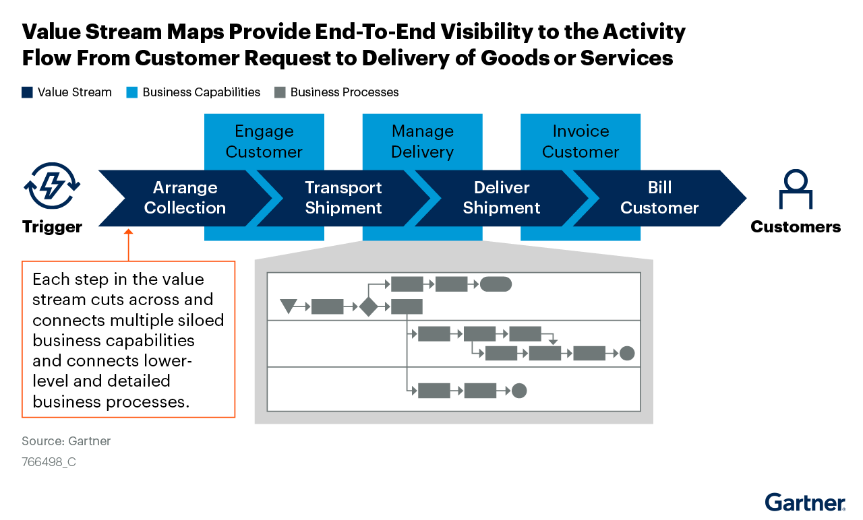
Sample Value Stream Map

Slide 23
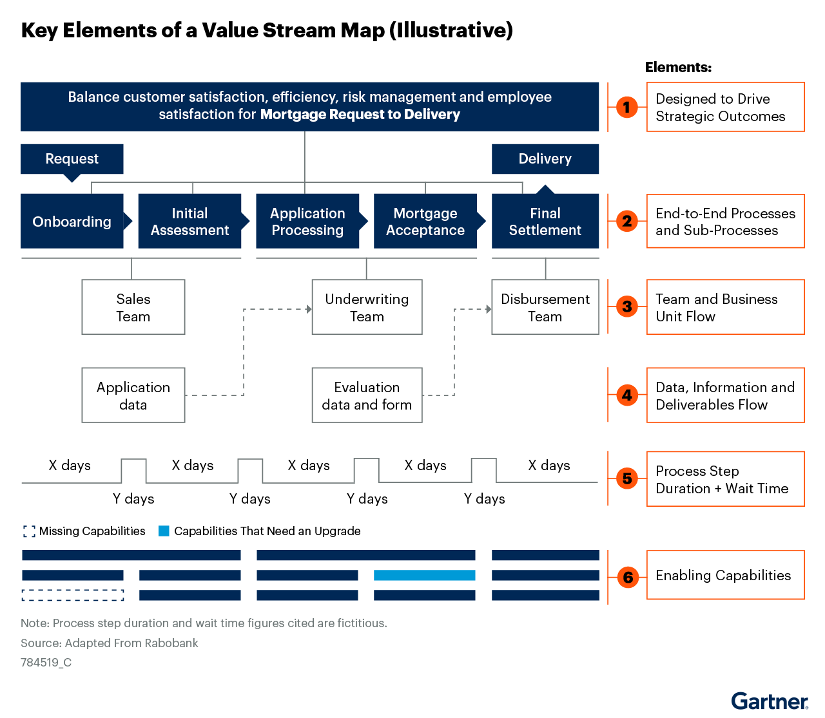
Sample Value Stream Map

